Slide 1
Valuation, Quantity Measurement,
Partner Country, Mode of Transport
Habib Khan United Nations Statistics Division
Notes:
1

Slide 2
Valuation
(NEW) It is recommended that the statistical value is established in accordance with the concept of market price in the SNA 2025 and BPM7, and by applying the cross-border principle of recording to determine a uniform point of valuation.
Market price/transaction value -> “the price actually paid or payable for the goods when sold for export to the country of importation”
The border of the compiling economy is treated as the uniform point of valuation.
In cases where the transaction value is missing or unacceptable, the statistical value of the goods should be established based on similar transactions including the identical goods for which the transaction value is acceptable for customs purposes.
Notes:
The transaction value of the goods, as defined in the WTO Customs Valuation Agreement as “the price actually paid or payable for the goods when sold for export to the country of importation,” is treated as their market price

Slide 3
Valuation
FOB and CIF
Exported goods should be valued on FOB basis.
include the transaction value of the goods, and the value of services performed to deliver goods to the border of exporting country
Imported goods should be valued on CIF basis.
include the transaction value of the goods, the value of services performed to deliver goods to the border of the exporting country and from the border of the exporting country to the border of importing country.
Countries are also encouraged to compile FOB-type value of imported goods.
Notes:
FOB-type values are currently used for the compilation of national accounts and balance of payments statistics.¹¹ FOB-type values of imported goods at the detailed level are important for reconciliation studies, the examination of bilateral trade symmetries, and trade negotiations since they provide a comparable valuation of the exports and imports of trading partners. Further, the difference between the CIF-type and the FOB-type value is an important indicator of the contribution of international transport charges to the purchaser prices of imported goods and for the compilation of transport services statistics.

Slide 4
Valuation
Invoice value (NEW)
Value that the seller charges the buyer and represents the value of an expected direct payment
The terms of delivery indicate the scope of costs included in the given invoice value.
Do NOT share a uniform point of valuation across transactions.
Corresponds more closely with the change of ownership principle in SNA and BOP. Might be adopted in future updates of both manuals.
Countries are encouraged to record invoice values. Should be noted that adoption for BOP would introduce an additional source of discrepancy between IMTS and the goods account.
Example

Slide 5
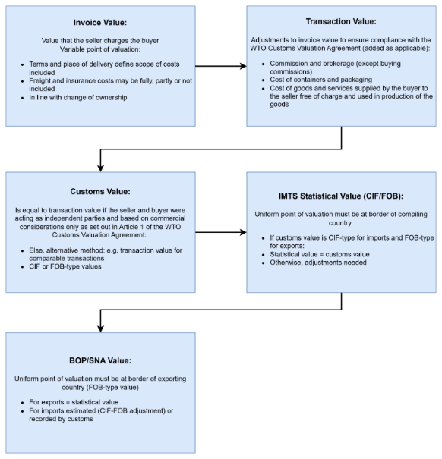
Valuation
Comparison of different types of valuation

Slide 6
Valuation
Selected issues
(NEW) Coins of precious metals (of legal tender but essentially not in circulation) be valued at the transaction value rather than at their face value.
Banknotes and securities not in circulation be valued at the transaction value of the printed paper rather than at their face value.
Media, whether or not recorded be valued at their full transaction value (and not at the value of unrecorded media). Media carrying customized software are to be excluded.
Electricity, gas, oil and water be valued net of any delivery charges not included according to FOB- or CIF type valuation.
Notes:
Frequently, contracts for the delivery of these goods include clauses where either the purchaser pays the seller a penalty in case they take delivery of less than a pre-specified minimum quantity (so-called “take-or-pay" clause) or the seller may repurchase part of the sold quantity from the purchaser before the physical delivery. These payments should not be included in the statistical value.
Electricity be valued net of any payments for the construction and maintenance of the transmission grid irrespective of whether those payments are included in the customs value.

Slide 7
Valuation
Selected issues (continued)
Goods under financial lease be valued based on the prices of similar goods crossing borders as the result of sale.
Goods for processing with or without change of ownership be valued at their full value.
Goods sold by factoryless goods producers (FGP) be valued including the value of the intellectual property product provided by the principal.
Returned goods be valued at the initial transaction value.
Goods bundled with services be valued on goods and the value of any services should be excluded.
Goods that cross borders as a result of transactions between related parties, mis-invoicing, etc. be valued at statistical value.

Slide 8
Valuation
Trade by currency (NEW)
National currency unit is preferable. However, if the national currency is subject to significant fluctuations, it might be appropriate to use a more stable unit of account.
It is recommended that if currency conversion is necessary, exchange rates as published by the competent national authorities should be used.
Both buying and selling rates are available -> use the midpoint between the two.
Multiple official exchange rates -> use actual rate applicable to specific transactions.
IMTS compilers are encouraged to record the invoicing currency -> of great interest to policy makers and balance of payments compilers.

Slide 9
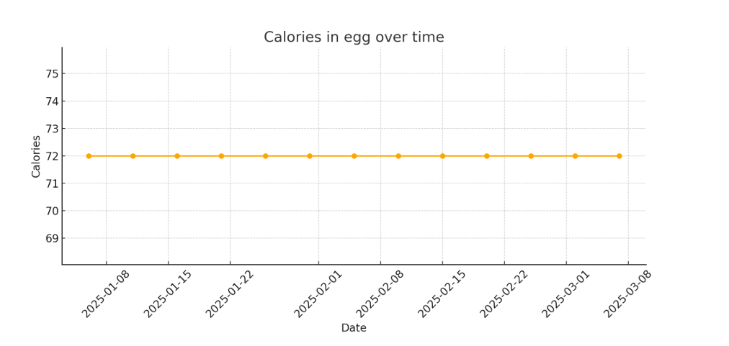
Quantity
Quantity measurement
Why measure quantity?
Planning of transport infrastructure.
Energy, agricultural and other commodity balances (e.g. food balance sheets).
System of Environmental Economic Accounts (SEEA), impact of international transport on the environment (e.g. trade in waste and e-waste).
Unit values, verification of trade values.
Reconciliation of asymmetries.
Trade indices.

Slide 10
Quantity
WCO Standards units of quantity
Weight³ | kilograms (kg) carat (carat)
Length | metres (m)
Area | square metres (m²)
Volume | cubic metres (m³) litres (l)
Electrical power | 1,000 kilowatt-hours (1,000 Kwh)
Number (units) | pieces/items (u) pairs (2u) dozens (12u) thousands of pieces/items (1,000u) packs (u (set/pack))
One of these standard units (SU) is specified for each HS six-digit subheading.
It is recommended that:
countries use the applicable WCO SU.
if SU is other than weight, also compile net weight.
if only gross weight is available, should record it and estimate net weight.
if a unit other than WCO SU is used, provide conversion factor to WCO SU, record original as supplementary quantity.

Slide 11
Quantity
Provisional extended list of IMTS Standard Units (NEW)
Why → common business practices/conventional units of quantity are sometimes different than WCO SU (e.g. Barrels for crude oil vs kg).
Countries are encouraged to compile supplementary quantity data using the provisional extended list.
284410 (natural uranium and its compounds), 100 kg (WCO SU), 65 kg U (IMTS SU)
Abbreviation | Description | Abbreviation | Description
BBL | Barrels | l alc 100% | Litre pure (100 %) alcohol - l alc. 100%
hive | Beehive | head | Head
12u | Dozens of items | kg/net eda | Kilogram drained net weight
kWH | Electrical energy in kilowatt-hours | kg C5H14ClNO | Kilogram of choline chloride
km | Length in kilometers | kg P2O5 | Kilogram of diphosphorus pentaoxide
TJ | Terajoule (gross calorific value) | kg H2O2 | Kilogram of hydrogen peroxide
1000u | Thousands of items | kg met.am. | Kilogram of methylamines
1000 m³ | Volume in thousand cubic meters | kg N | Kilogram of nitrogen
1000 L | Volume in thousands of liters | kg KOH | Kilogram of potassium hydroxide (caustic potash)
g | Weight in grams | kg K2O | Kilogram of potassium oxide
1000 KG | Weight in 1000 kilograms | kg NaOH | Kilogram of sodium hydroxide (caustic soda)
Bq | becquerels | kg 90% sdt | Kilogram of substance 90 % dry
gi F/S | Gram of fissile isotopes | kg U | Kilogram of uranium
GRT | Gross register ton | ct/l | Carrying capacity in tonnes
GT | Gross tonnage | ce/el | Number of cells/elements

Slide 12
Quantity
Validation and Uniformity
It is recommended that quantity information be validated:
check for inconsistencies and outliers;
estimate/impute missing and outlier quantities;
identify estimated/imputed quantities, provide methodology in metadata.
For uniformity, it is recommended that:
apply same quantity units for all individual six-digit HS subheadings and more detailed headings;
in metadata, provide clear description of the quantity units and conversion factors;

Slide 13
Partner country
Partner country
It is recommended that:
In the case of imports, the country of origin be recorded; and
In the case of exports, the country of last known destination be recorded.
It is recommended that country of consignment is recorded as the second partner country attribution for imports. For exports, it’s encouraged.
Country of consignment -> country from which goods were dispatched to the importing country.
(NEW) Countries are encouraged to record country of origin for re-exports.

Slide 14
Partner country
Partner country attribution for direct trade
Commodities are exported directly from country A to country B, no intermediate countries.
For exports of A:
Country of last known destination: B
Country of consignment: B
For imports of B:
Country of origin: A
Country of consignment: A

Slide 15
Partner country
Partner country attribution for indirect trade
Commodities are first shipped from country A to B, and then from B to C but no commercial transactions or other operations occur in country B that change the legal status of the goods.
For exports of A:
Country of last known destination: C (if known)
Country of consignment: B
For imports of C:
Country of origin: A
Country of consignment: B
Country B should exclude this transaction as these are goods simply being transported, i.e., goods under “in transit” or “in transshipment”.

Slide 16
Partner country
Partner country attribution for indirect trade
If substantial transformation has taken place in Country B which meets the rules of origin criteria:
For exports of A:
Country of last known destination: B
Country of consignment: B
For imports of B:
Country of origin: A
Country of consignment: A
For exports of B:
Country of last known destination: C
Country of consignment: C
For imports of C:
Country of origin: B
Country of consignment: B

Slide 17
Partner country
Partner country attribution for indirect trade
If no substantial transformation has taken place in Country B, or the rules of origin criteria were not met:
For exports of A:
Country of last known destination: C (if known)
Country of consignment: B
For imports of B:
Country of origin: A
Country of consignment: A
For re-exports of B:
Origin of re-export: A
Country of last known destination: C
For imports of C:
Country of origin: A
Country of consignment: B

Slide 18
Partner country
Partner country attribution for selected goods
Electricity and natural gas
Impossible to track an individual physical unit.
Compilers are encouraged to familiarize themselves with the workings of the electricity and natural gas markets, and adjust the partner country attribution accordingly.
Used goods
Country of consignment may be more informative for trade policy purposes than the country of origin.

Slide 19
Mode of transport
Mode of transport classification
Use of MoT classification is recommended.
It is further recommended that the main categories (1-digit level) are used. Use of subcategories (2- or 3-digit level) is encouraged.
It is recommended that countries compile MoT at the most detailed commodity level.
It is recommended that the MoT recorded is determined by the means of transport used when goods enter or leave the statistical territory.

Slide 20
Mode of transport
MoT: special issues
National practice
Countries may add a more detailed breakdown. It is recommended that countries clearly describe the contents of the categories used and any deviations.
Category “4.4 Not elsewhere classified” should be used when the available information does not allow attribution to any other MoT categories.
Informal cross-border trade (ICBT)
May use different classification based on country needs
Multimodal transport
Countries may wish to compile MoT based on predominant MoT criterion.
“Predominant” can be defined in terms of cost or distance. It is recommended to provide details in metadata.

